Slide 1

The BIG Upgrade Deck v1.1

Slide 2
Disclaimer
This presentation is provided for informational and training purposes.
The goal is to spread awareness regarding upgrade functionality and engage the community to share ideas and solutions regarding upgrade issues.
The information in the deck is presenting the current state and may become obsolete. Please refer to the official documentation to verify if the information is still applicable.
Sample code included in this presentation is made available AS IS.
In case something is in-correct, not up-to date, not clear enough or you would like to get more information on certain topic please open an issue at:
https://github.com/microsoft/BCUpgrade
And we will upgrade this deck.

Slide 3

Alternative way to ask questions
A Twitter hashtag for the AL community
Follow #bcalhelp on Twitter to learn about other people’s issues (and help out if you can)
Include #bcalhelp in a tweet with a question. Maybe someone out there knows the answer
This is not controlled by Microsoft.
Notes:
https://pixabay.com/illustrations/twitter-logo-twitter-bird-1788039/

Slide 4
Table of contents
The Discontinuation overview
New AL Profiles – Replacement for XML profiles (Configuration / Personalization)
Refactoring Client Side Dlls (client/side printing, accessing the machine)
Replacing Integration Management with System Ids (Pending)
Before upgrading to 15.x
Choosing Cumulative Update, refactoring out of breaking SQL changes, renaming and renumbering
Examples of refactoring breaking SQL Changes in C/AL
Building the 15. app
Target architectures
Refactoring to System App
Moving tables and fields
Upgrade to 15
Upgrade steps explained (PowerShell script)
Upgrade tooling (Upgrade codeunits, Upgrade Tags, Execution Context API, Obsolete Properties)
SaaS Upgrade
Migrating from OnPrem to Cloud - DataMigration Tool to uplift data to cloud
SaaS – to – SaaS upgrade for Per Tenant Extensions and App Source extensions (If you are already in the cloud)

Slide 5
The discontinuation overview
Discontinued:
Planning to discontinue:
C/AL – replaced with AL
Cside – Replaced by VS Code
Windows Client – replaced by Web Client
XML Profiles – AL Profiles (in code)
Refactoring:
System App refactoring
Integration management – replaced by $systemId
(Integration Records)

Slide 6
New AL Profiles
What:
The XML Profiles used for Configuration and Personalization are discontinued in 15.x
Why:
They are replaced by the new AL Profiles. The new profile is stored as code, it is more readable and easier to maintain
How:
Implement new profiles by configuring in UI and saving new AL profile or define in code
The tables with old XML profiles are still present in the system for upgrade purposes (they are not used), there is upgrade code that can be customized if needed
Documentation:
https://docs.microsoft.com/en-us/dynamics365/business-central/dev-itpro/developer/devenv-profile-object
https://docs.microsoft.com/en-us/dynamics365-release-plan/2019wave2/dynamics365-business-central/customize-user-profile-without-writing-code

Slide 7
Removing Integration Management (Integration Records)
What:
We are planning to discontinue Integration Management codeunit and the use of the Integration Records
Why:
Using Integration Records has a large performance hit:
For each record update (CRUD) we need to change a Integration Record, so we are tripling the number of SQL calls
Because we use global subscribers, bulk inserts, deletes and modifies are disabled
Integration records table is a high traffic table – we are spending time waiting on the lock and getting a number of lock timeouts, also few concurrency issues (another user has modified this record error)
How:
We will support the integration records for one year. We have added an unique identifier $systemID to every table and will add ModifiedOn date in following releases and refactor CRM integration and APIs to fully use the new system
If you have added any fields to the integration records, please reach out to us – via yammer, github and other channels.

Slide 8
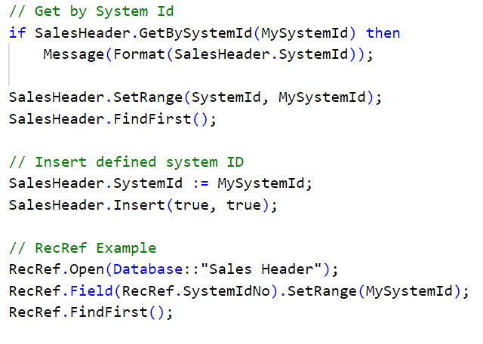
New 15.x feature - Immutable Keys - $systemID
$systemId is an immutable key. It is possible to set before Insert, once inserted it cannot be changed. If not set the Insert statement will generate a new one.
Datatype is GUID
It is possible to filter on the value, GetBySystemId and RecRef has a SystemIdNo to allow accessing systemId in a generic way
During upgrade we will move the keys out of Integration Record to $systemId in the platform during Sync Step.
After upgrade, Integration Management will set $systemID as ID field of the Integration Record before creating the Integration Record. This way both systems will have the same ID.

Slide 9
SystemId upgrade considerations
We need to support Integration records for one year, so we have ensured that Integration ID == $systemId (for now), both systems will return the same value.
For existing tenants we will set the Integration ID from integration record to $systemId field, during upgrade. This was needed to ensure we do not break the existing integrations (if Integration ID was shared with outside services).
The move of Integration ID to $systemId will happen automatically during the sync step of upgrade.
If you would like to set the SystemId to Integration ID, make sure Integration record table is up to date before upgrade.
Delete Integration Records if you don’t use them or would like to get new set of IDs

Slide 10
Deprecating Integration Records – Audit Feature
To fully deprecate the Integration Records we need ModifiedBy and ModifiedDate functionality.
We are planning to add these fields to every record (same as $systemId).
Feature is currently scheduled for 16.x – work has not started yet

Slide 11

The Big Picture
Where should each of the Lego’s fit?

Slide 12

Upgrade journey
– The Destination
MS
Base App
Partner Apps
Customizations
MS System Application

Slide 13
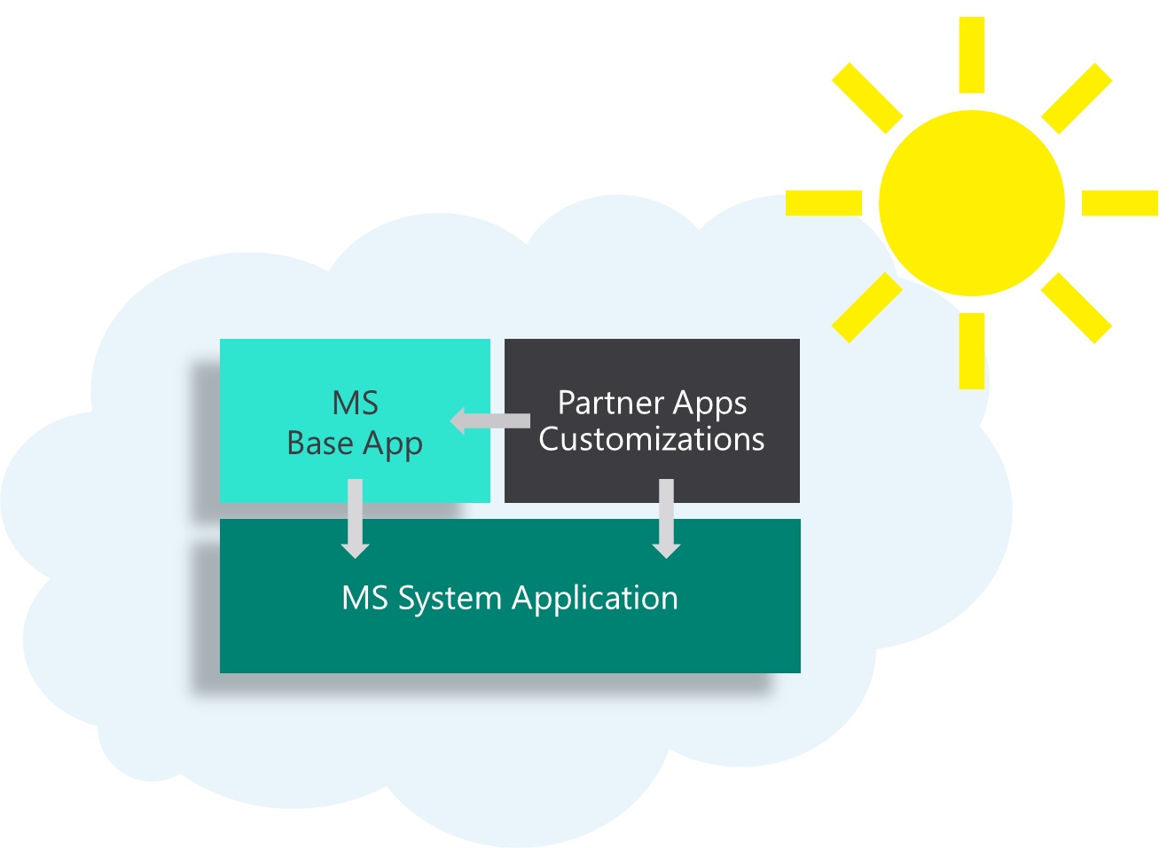






Upgrade journey – the plan
Step 1.
Upgrade to 14.x
Step 2.
Upgrade to 15.x
Step 3.
Uplift data to cloud
OnPrem
15.X
(2019 Wave 2)
OnPrem
14.X
(Spring 2019)
C/AL + AL
AL

Slide 14


Step 1 – Upgrade to 14.x Important considerations
Minimize the footprint – Before upgrade refactor as much possible on C/AL.
Focus on removing modifications on base app objects. Recommendation is to start with tables first. We recommend to organize the code in 3 folders – unmodified, modified, added. This way you have a good overview and it is easier to merge.
Always upgrade to the latest compatible CU – 14.5… Make sure that CU was not released after target version, For example DO NOT Upgrade from 14.6 released in October to 15.0 Released in September. KB Article will state minimal supported target version
Make sure SQL Schema contains ONLY ADDITIVE changes. AL does not support doing breaking SQL Changes, so make base app compatible in C/AL.
Renumber and rename to ISV Range (App store) or renumber to 50.000 range (Per Tenant Extensions). It is easier in C/AL
For organizing files you can look at - https://freddysblog.com/2019/08/02/organizing-your-al-files/

Slide 15
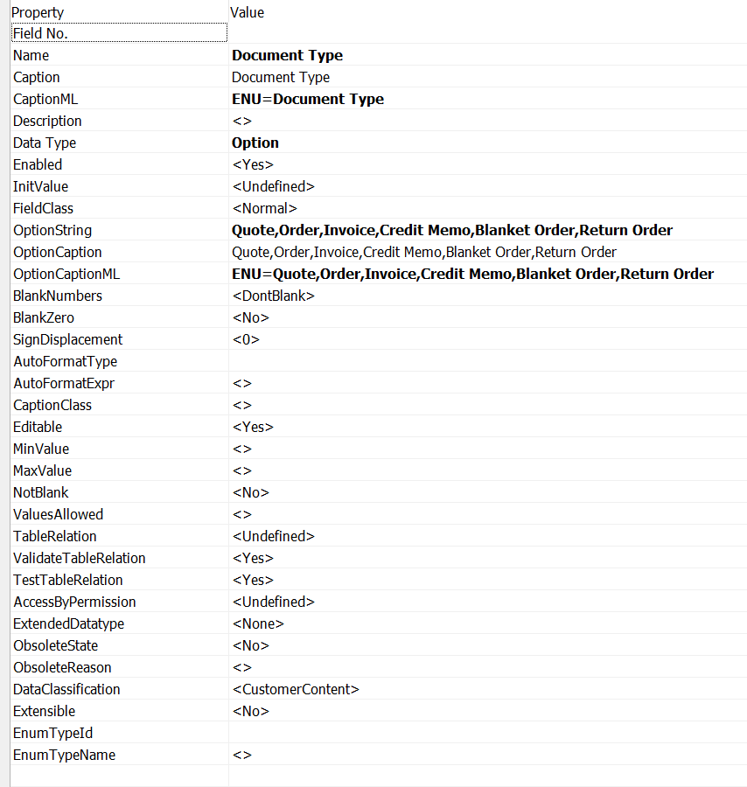
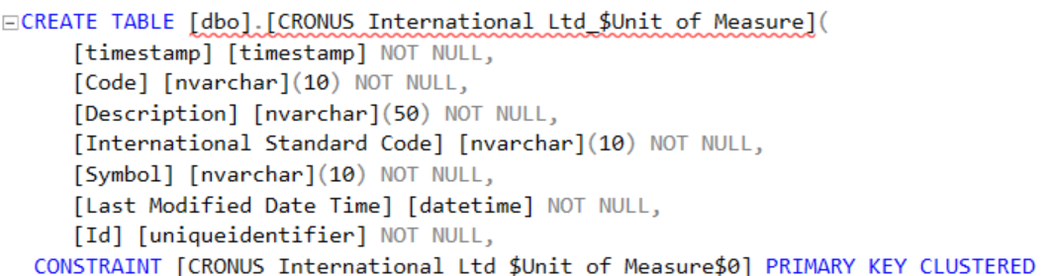
Only additive SQL Schema changes
But it is not
May look hard
Table names
Field name, type, length
Keys (primary, secondary)
We store only few properties on SQL, everything else is stored in metadata tables (Object Metadata for C/AL or NAV App tables for extensions)
We do not have capabilities to handle breaking SQL changes in AL. On prem because of direct SQL access and Sync-NAVTenant –Force we can workaround, it is not possible in SaaS. The strong recommendation is to refactor away from breaking SQL changes.

Slide 16
Breaking changes – Simple Examples
Change
Action
Changed primary key on Customer to – No., Country Code
Change key back, write upgrade
2. Changed datatype – e.g. Chain Name from Code to Text
Change back, force or write upgrade
3. Deleted or renamed field or table
Put it back

Slide 17

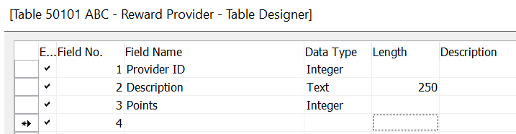
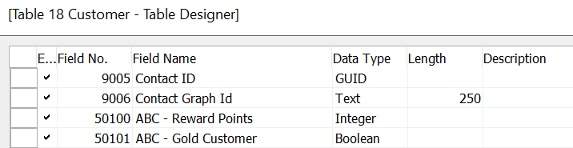
Additive changes
Adding Tables
Adding Fields to existing tables

Slide 18
How to change primary key – Refactoring of Custom Report Layouts
This is an example of what needs to be done to change a key in C/AL. This example outlies a breaking change we did approx. 4 years ago. We have stopped doing breaking SQL changes 2 years ago, so we will have to use this real-life example since it gives a very good overview of how to change a primary key. You can use it to refactor away from breaking changes - to refactor and set the key on the Base App table back.
This was a complex change that took approx. 5-6 developer days to implement (both upgrade and code).

Slide 19
Changing keys – Refactoring of Custom Report Layouts
Problem - It was not possible to upgrade Custom Report Layouts and design was fragile:
Custom Report Layout was stored in a blob – we cannot tell if it was customized
Keys were autoincrementing integers – we could not tell which report is which and if it is a report that was shipped out of the box or a report users have created
We had issues with RapidStart that was used to create new companies, since it could overwrite wrong data (data per company is no, keys are autoincrementing integers)
Solution:
Introduce a code key, prefix reports shipped out of the box with MS-, others will not have a prefix. This means changing a key, plus upgrade of keys all tables that are referencing the Custom Report Layout ID
Make reports shipped out of the box read-only, so we can replace them if needed (simple upgrade). Users need to duplicate layout and customize. This is a good example of designing for upgrade.
Assume all records in existing tenants are customized and insert new ones (will not duplicate much)

Slide 20
Changing key
Updating key:
Forcing a change of primary keys would drop all the data in the table, so we need to move the records.
For this purpose we need to introduce a buffer table to move the records before the upgrade.
Move is the only option available for this type of change, because we need to insert the records back.
Table 9650 Custom Report Layout Before - ID is integer
KEYS
{
{ ;Id ;Clustered=Yes }
{ ;Report ID,Company Name,Type } }
}
Table 9650 Custom Report Layout After - Code is Code[20]
KEYS
{
{ ;Code ;Clustered=Yes }
{ ;Report ID,Company Name,Type }
}

Slide 21
Buffer table example
OBJECT Table 104052 UPG Custom Report Layout
{
OBJECT-PROPERTIES
{
Date=;
Time=;
Version List=;
}
PROPERTIES
{
DataPerCompany=No;
}
FIELDS
{
{ 1 ; ;ID ;Integer ;AutoIncrement=Yes }
{ 2 ; ;Report ID ;Integer }
{ 4 ; ;Company Name ;Text30 ;TableRelation=Company }
{ 6 ; ;Type ;Option ;InitValue=Word;
OptionString=RDLC,Word }
{ 7 ; ;Layout ;BLOB }
{ 8 ; ;Last Modified ;DateTime ;Editable=No }
{ 9 ; ;Last Modified by User;Code50 ;Editable=No }
{ 10 ; ;File Extension ;Text30 ;Editable=No }
{ 11 ; ;Description ;Text80 }
{ 12 ; ;Custom XML Part ;BLOB }
}
KEYS
{
{ ;ID ;Clustered=Yes }
}
FIELDGROUPS
{
}
CODE
{
BEGIN
END.
}
}
Custom Report Layout buffer table
ID must be in upgrade range or a range that is within license; name needs to be different we recommend prefixing with UPG –
Keys and fields must be identical otherwise upgrade will fail.
Buffer tables are created by renumbering , adding UPG and removing the code from the table

Slide 22
Populating buffer tables
In upgrade codeunit in [TableSyncSetup] method add a line to Move from Main table to buffer:
DataUpgradeMgt.SetTableSyncSetup(DATABASE::"Custom Report Layout",DATABASE::"UPG Custom Report Layout",TableSynchSetup.Mode::Move);
Note - [TableSyncSetup] trigger fires before any changes are done to SQL. It will contain new object metadata, however the SQL schema is on the old version (not updated yet). SQL is going to be updated after trigger moves or copies data to buffer tables.
Last step is to write upgrade code

Slide 23
Example of upgrade code
Coding pattern is the same
Find all records from buffer table
Use REPEAT UNTIL to insert values with new key
Recommendation is to cleanup the buffer table after done with upgrade, delete the object and force sync the SQL
[UpgradePerDatabase]
PROCEDURE UpgradeCustomReportLayout@1041();
VAR
UPGCustomReportLayout@1000 : Record 104052;
CustomReportLayout@1001 : Record 9650;
ReportLayoutSelection@1003 : Record 9651;
BEGIN
UPGCustomReportLayout.SETAUTOCALCFIELDS(Layout,"Custom XML Part");
IF NOT UPGCustomReportLayout.FINDSET THEN
EXIT;
REPEAT
CLEAR(CustomReportLayout);
CustomReportLayout.TRANSFERFIELDS(UPGCustomReportLayout,FALSE);
CustomReportLayout.Code := GetReportLayoutCode(UPGCustomReportLayout.ID);
CustomReportLayout.INSERT(TRUE);
UNTIL UPGCustomReportLayout.NEXT = 0;
END;

Slide 24
Recommendations on how to resolve changing the key
Only reason why you would need a new primary key is to store data in a different way, for this we would recommend implementing a new table.
1. Investigate if you need the new key – could you simply filter (SETRANGE, SETFILTER) on the new value?
You could also add global subscribers on Table Insert and Modify to ensure new field is set (do this only if it is really needed because of performance impact)
2. If changing the key is a must and cannot be avoided, consider introducing a new table. Copy the existing fields if they are needed. In effect changing a key is the same as introducing a new table, code is going to diverge, and the purpose is different, so new table may be a cleaner option.
To maintain the new table see if you can use the Shadow Table pattern – good example is codeunit 5477 "Sales Invoice Aggregator“. Cons of using this approach is performance, pros it is simple design that is easy to implement

Slide 25
Changing field type example
For each of the tables that are referencing the primary key of Custom Report Layout table, we need to introduce a buffer table as well since field needs to be changed from integer to code[20]
Forcing a change of data-type would drop values on the custom report layout id fields.
Copy is the proper action here since we want to keep the data and only update reference to custom report layout

Slide 26
Example of Report layout selection buffer table
OBJECT Table 104053 UPG Report Selections
{
OBJECT-PROPERTIES
{
Date=;
Time=;
Version List=;
}
PROPERTIES
{
}
FIELDS
{
{ 1 ; ;Usage ;Option ;OptionString=S.Quote,S.Order,S.Invoice,S.Cr.Memo,S.Test,P.Quote,P.Order,P.Invoice,P.Cr.Memo,P.Receipt,P.Ret.Shpt.,P.Test,B.Stmt,B.Recon.Test,B.Check,Reminder,Fin.Charge,Rem.Test,F.C.Test,Prod. Order,S.Blanket,P.Blanket,M1,M2,M3,M4,Inv1,Inv2,Inv3,SM.Quote,SM.Order,SM.Invoice,SM.Credit Memo,SM.Contract Quote,SM.Contract,SM.Test,S.Return,P.Return,S.Shipment,S.Ret.Rcpt.,S.Work Order,Invt. Period Test,SM.Shipment,S.Test Prepmt.,P.Test Prepmt.,S.Arch. Quote,S.Arch. Order,P.Arch. Quote,P.Arch. Order,S. Arch. Return Order,P. Arch. Return Order,Asm. Order,P.Assembly Order,S.Order Pick Instruction,,,,,,,,,,,,,,,,,,,,,,,,,,,,,,,,C.Statement,V.Remittance,JQ }
{ 2 ; ;Sequence ;Code10 ;Numeric=Yes }
{ 3 ; ;Report ID ;Integer }
{ 7 ; ;Custom Report Layout ID;Integer ;Editable=No }
{ 19 ; ;Use for Email Attachment;Boolean ;InitValue=Yes }
{ 20 ; ;Use for Email Body ;Boolean }
{ 21 ; ;Email Body Layout ID;Integer }
}
KEYS
{
{ ;Usage,Sequence ;Clustered=Yes }
}
FIELDGROUPS
{
}
CODE
{
BEGIN
END.
}
}
Similar implementation as Custom Report Layouts buffer table

Slide 27
Changing field type Upgrade code example
Copy is used since we only need to modify one field
DataUpgradeMgt.SetTableSyncSetup(DATABASE::"Report Layout Selection",DATABASE::"UPG Report Layout Selection",TableSynchSetup.Mode::Copy);
We loop over all buffer records and generate new code value based on previous value
[UpgradePerDatabase]
PROCEDURE UpgradeReportLayoutSelection@3015();
VAR
UPGReportLayoutSelection@1000 : Record 104089;
ReportLayoutSelection@1001 : Record 9651;
Code@1003 : Code[20];
CustomReportLayoutID@1002 : Integer;
BEGIN
IF NOT UPGReportLayoutSelection.FINDSET THEN
EXIT;
REPEAT
ReportLayoutSelection.GET(UPGReportLayoutSelection."Report ID",UPGReportLayoutSelection."Company Name");
ReportLayoutSelection."Custom Report Layout Code" := GetReportLayoutCode(UPGReportLayoutSelection."Custom Report Layout ID");
ReportLayoutSelection.MODIFY;
UNTIL UPGReportLayoutSelection.NEXT = 0;
END;

Slide 28
Renaming fields or tables
Rename:
There is no reason to rename Microsoft owned objects, the cost of maintain and merging
the renamed objects is too high
For added objects (table/fields) you can simply rename and set Force for Table Sync Setup (if needed):
DataUpgradeMgt.SetTableSyncSetup(DATABASE::"Report Layout Selection", 0,TableSynchSetup.Mode::Force);
Be careful when forcing the table sync, do it as a separate step and verify the results since it will force entire table. Test the change well and do backup before upgrade.

Slide 29
Renumbering fields or tables
Renumbering:
There is no good reason to renumber objects shipped out of the box.
If you would want to renumber your own objects, renumbering (Changing field/table IDs) is going to drop the data.
For renumbering tables you can use Copy as in the example above. It is the fastest approach
For renumbering fields you need to use Copy and iterate over Buffer table records and set the values back.
If Renaming and Renumbering is difficult, we are looking into implementing feature to make it easier in 15 (in AL), the goal is to make it as automatic as possible

Slide 30
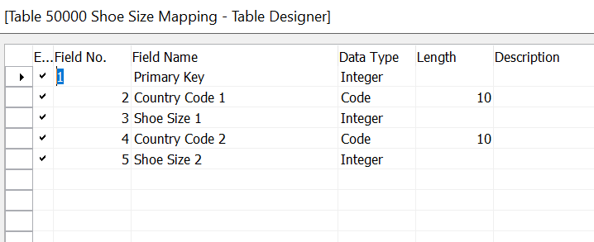
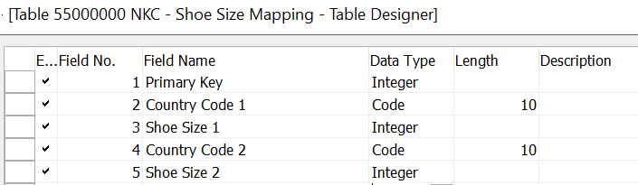
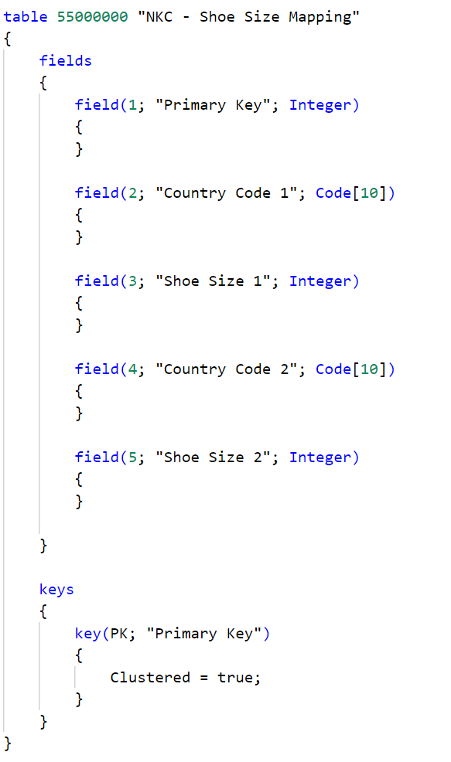
App Store + Per tenant extensions – Number range and names
PTE – are in 50000 range
App source – follow app source process to get a 3-letter prefix or a suffix and a range
If you complete renaming and renumbering in C/AL, we will move full tables automatically to extensions if the ID and the Name Matches.

Slide 31
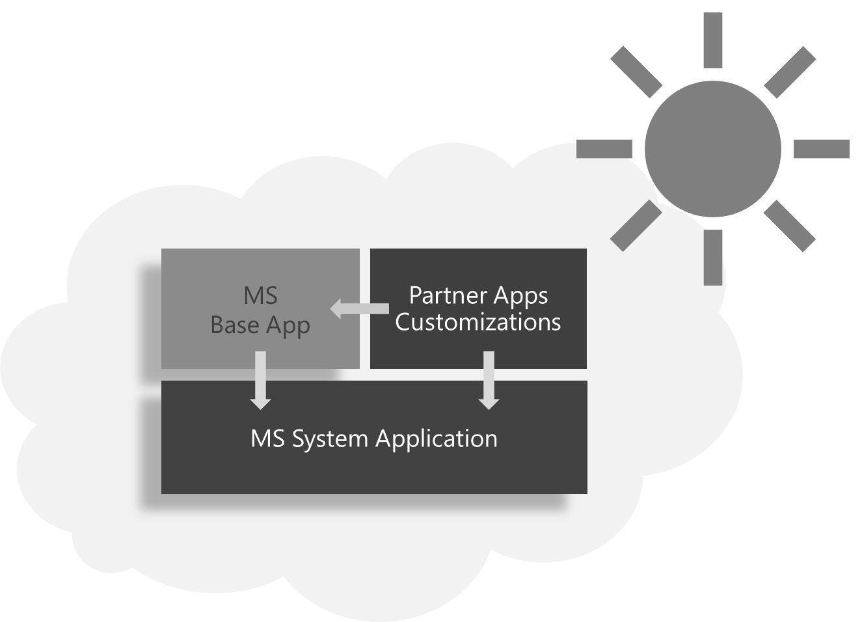

Upgrade journey – Step 2.
Step 1.
Upgrade to 14.x
Step 2.
Upgrade to 15.x
Step 3.
Uplift data to cloud
OnPrem
15.X
(2019 Wave 2)
OnPrem
14.X
(Spring 2019)
Developers
No landing place
C/AL + AL
AL

Slide 32
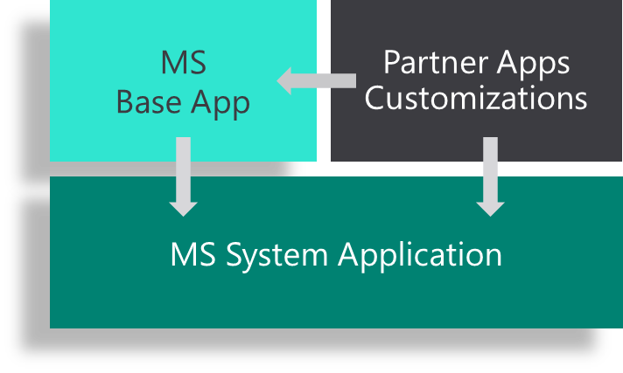
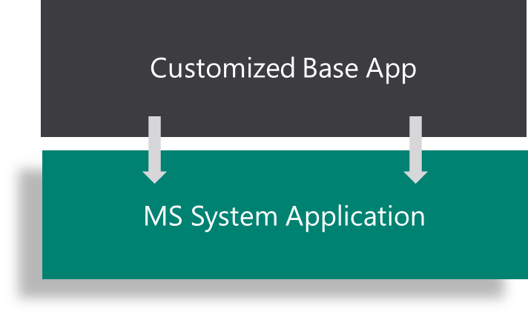
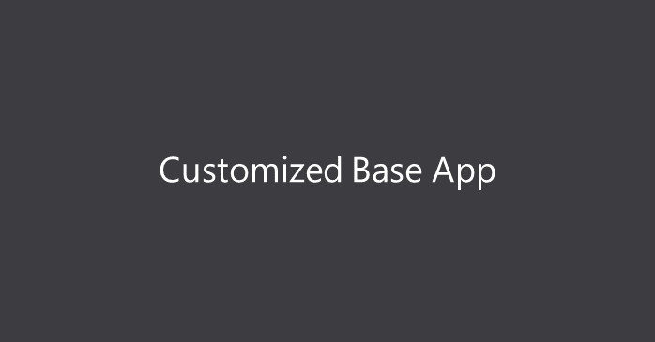

15.x Target architectures
Highly Recommended
3. Extract customizations to extensions
OK
2. Refactor to base app
Simple
Not Recommended
1. Convert to AL
(technical upgrade)
Simple
Developers

Slide 33
Upgrade 15 considerations
Before upgrading minimize the number of customized base app objects on 14
Adopt system app
Refactor as much as possible, do not have any breaking SQL changes
After upgrade there is no tooling right now to help with moving or removing SQL tables.
We have to use obsolete fields.

Slide 34






Breaking the Monolith: Introducing the System Application
Base Application
Base Application
Fully Componentized
and Extensible
Well-Documented Public
Functions and Modules
Foundation upon which the Business Application
of the future can be built
Encapsulated
Complexity
GitHub Contribution
Model
Versioned and Stable
Public Functions
Enhanced Security
Quick Compilation
and Deployment

Slide 35
System application
We have introduced a set of strong interfaces around core functionality
We are free to change internal implementation of any of the module – this can even include moving some of the logic/tables to Platform (C# code)
Do not customize System Application – it may be hard to resolve issues
If you have problems with adopting System Application or any other feedback, please provide feedback on GitHub

Slide 36
All System Application Modules
Assisted Setup
Auto Format
Azure AD Graph
Azure AD Licensing
Azure AD Plan
Azure AD Tenant
Azure AD User
Azure AD User Management
Azure Key Vault
Base64 Convert
BLOB Storage
Caption Class
Client Type Management
Confirm Management
Cryptography Management
Cues and KPIs
Data Classification
Data Compression
Date-Time Dialog
Default Role Center
DotNet Aliases
Environment Information
Extension Management
Field Selection
Filter Tokens
Headlines
Language
Manual Setup
Math
Object Selection
Password Dialog
Record Link Management
Recurrence Schedule
Satisfaction Survey
Server Settings
System Initialization
Tenant License State
Translation
Upgrade Tags
User Login Times
User Permissions
User Selection
Video
Web Service Management
Source and Documentation: github.com/microsoft/ALAppExtensions

Slide 37

…jumping into GitHub
Everything you need to know about the System Application, is on GitHub!
Let’s go there!
github.com/Microsoft/ALAppExtensions
Notes:
So much for the introduction!
The rest -> GitHub.
Every new module ¨-> open sourced for you to contribute to.
Inviting you to help shape the application you need,
Deliver your best work.
Let’s try to dive in to GitHub to see what’s there.
Example: Cryptography with PR on Rijndael.
Focus on Breaking Changes document.

Slide 38
Converting code documentation
C/AL to AL tool is on version 14.x, you need to get latest compatible CU update
The tool is automatic
We recommend using docker to automate the process
We recommend organizing files in 3 folders and minimizing the numbers of files Base App files you have customized – see the link below
Documentation:
https://docs.microsoft.com/en-us/dynamics365/business-central/dev-itpro/developer/devenv-txt2al-tool
https://freddysblog.com/2019/04/15/c-al-to-al-extension/
https://freddysblog.com/2019/04/15/c-al-to-al-code-customizations/
https://freddysblog.com/2019/07/31/preview-of-dynamics-365-business-central-2019-release-wave-2/
https://freddysblog.com/2019/08/02/organizing-your-al-files/

Slide 39
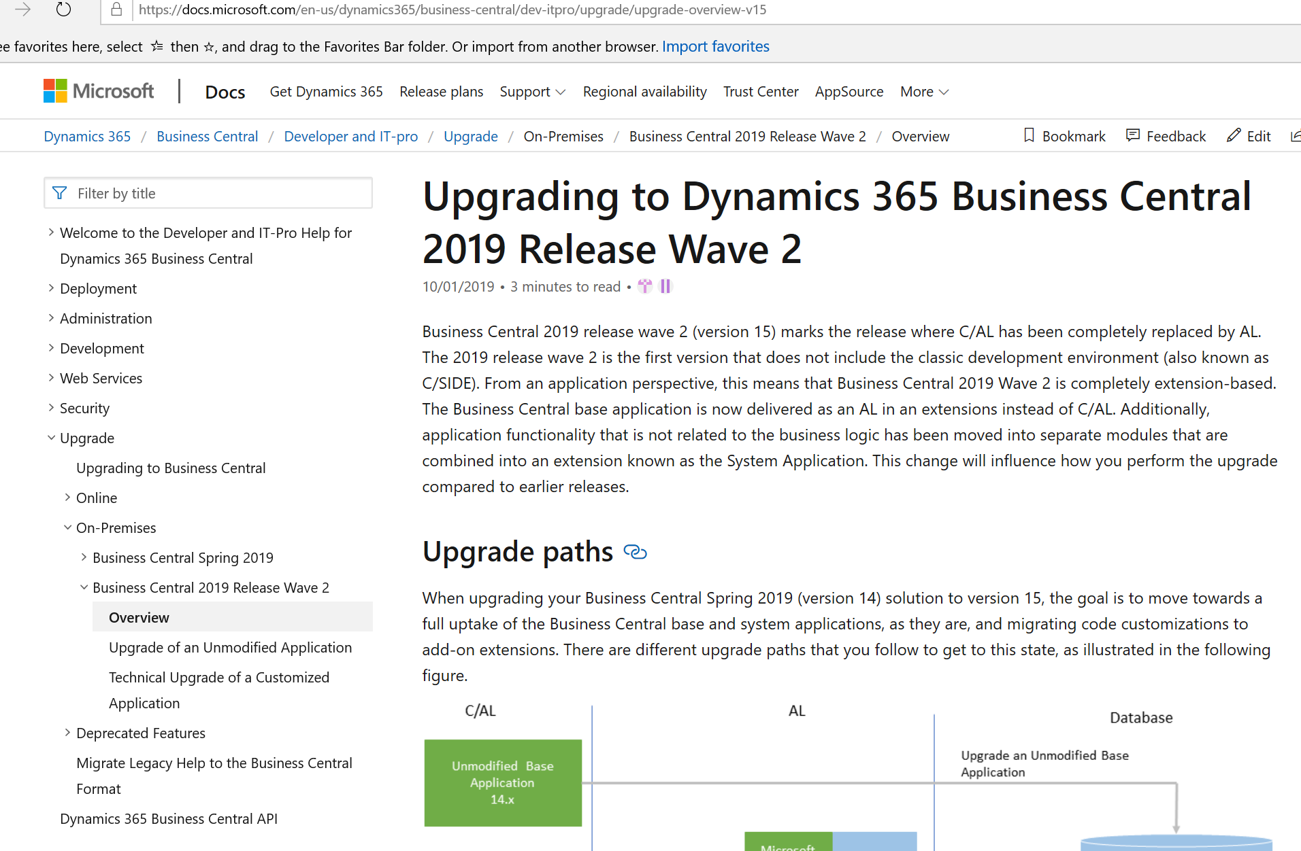
Upgrade documentation
Main upgrade topic:
https://docs.microsoft.com/en-us/dynamics365/business-central/dev-itpro/upgrade/upgrade-overview-v15

Slide 40
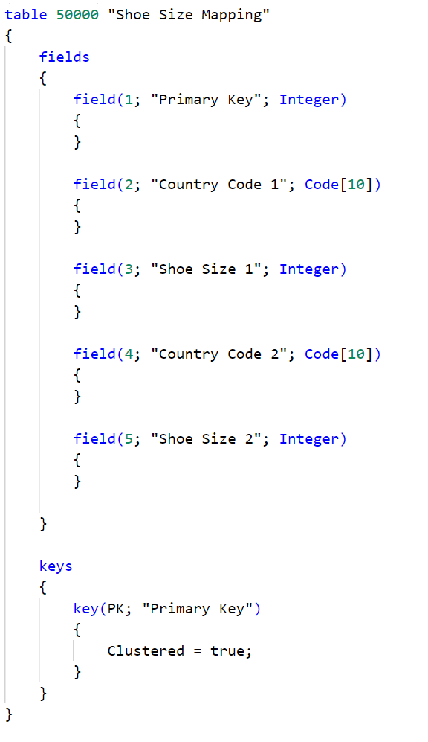
Moving tables from C/AL to Extension
Automatically transferred
Names and IDs must match

Slide 41
Moving tables from C/AL into Extension
The move is simple – app will take the ownership of the tables automatically.
For this to happen we need to append the App Id guid to all tables that app owns in SQL and update the metadata in related system tables (Nav Object Metadata and similar).
Move will be executed only if Name and ID of the Table matches in C/AL and AL. Fields are not used to determine if table can be moved to extension automatically . If the fields do not match, we will move the table and Latter upgrade steps will most likely fail.
Only possible from C/AL to AL. It is currently not possible to move tables from one extension to another
Executed during Sync-NAVApp package in the upgrade code
You can use Test-NAVTenantDatabaseSchema to verify if all tables were moved
https://docs.microsoft.com/en-us/powershell/module/microsoft.dynamics.nav.management/test-navtenantdatabaseschema?view=businesscentral-ps-15

Slide 42
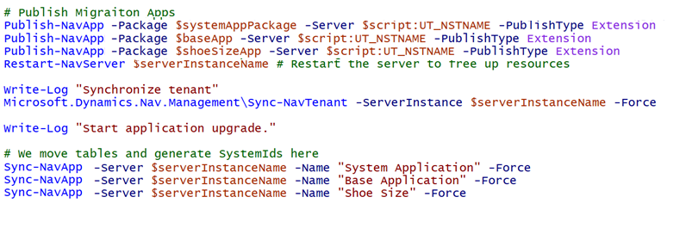
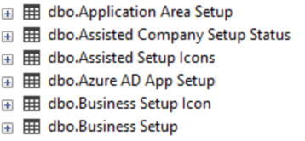
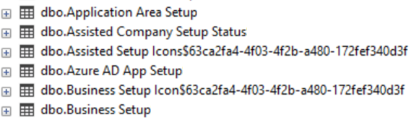
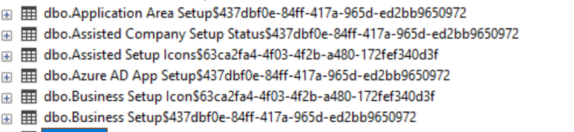
Moving tables to AL
Slide is animated - We add GUIDs to tables as we sync apps. Syncing system application will add the first guid, syncing base application will add the second guid and so on…
At the Sync-NavApp step we will look at the extensions metadata, find the tables by the name and ID and update it in SQL
This is for demonstration purposes only. To see the proper script look at https://github.com/microsoft/BCUpgrade/blob/master/15X%20-%20Business%20Central%202019%20Wave%202/Example/UpgradeLibrary.psm1

Slide 43
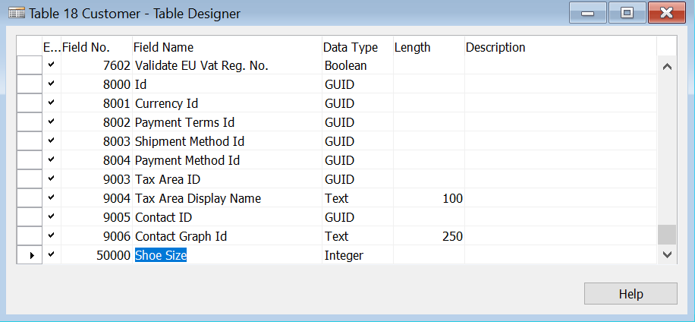
Moving added fields
Currently not possible to do automatically
Can be done via Obsoleting
You need to Obsolete the field in C/AL
Consider renaming and renumbering the C/AL field to save on refactoring if the field is already named and in proper ID range
Introduce a new field in AL
Write upgrade code or install code to get all records and move old field to new one
Ensure this code is executed only once

Slide 44
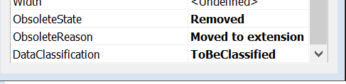
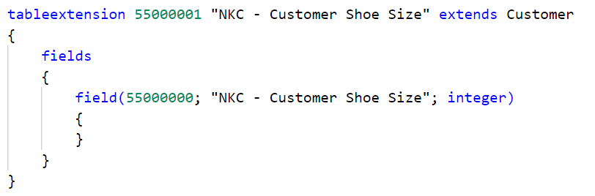
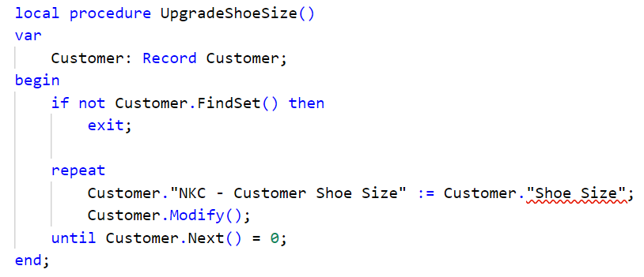
Moving fields to table extensions - example
Marking as removed
Adding table extension
Field no and name must be different
Write Upgrade code to loop over and copy from Upgrade or OnInstall trigger

Slide 45
Extension Uplift - Moving tables to extensions alternative
This is a workaround until we get a full support, it is applicable only On-Prem. Steps needed:
In AL write extension tables – keep the same numbers and the name (or renumber and rename if you want to get to AppStore – PTE)
Introduce a buffer table (copy of the table with different name and number) in 14.x and remove the fields added from BaseApp tables
Copy the tables with added fields to the buffer table (Use copy in the TableSyncSetup)
Do 14 -> 14 upgrade – this will remove added fields, and copy the tables to the buffer
In the extension copy the values from the buffer to the table extension
Pros:
No rename needed, renaming and renumbering is easy if necessary
Cons:
Works only On-Prem
Be careful when syncing with force since it is force syncing entire table
We recommend to automate the process

Slide 46
Moving added fields On-Prem - Workarounds
If you are still On-Prem and would like to get the same architectures as on SaaS and do not want to wait, MVPs wrote blogposts with workarounds.
E.g. you may look into this blog article: https://www.hougaard.com/uplifting/. It contains the automated way of moving data via SQL Scipts. This approach cannot be used if you have an extension in SaaS at this moment.
We have not tested these approach, so we do not know if they work.
Potential Risks:
SQL schema generated would not match the schema from the extension
You need to make sure that the contents of the Object Metadata, Object Metadata Snapshot and related Object tables (Storing C/AL code) is updated correctly
You need to make sure that the contents of the NAV App Object Metadata is updated correctly (Stores AL code)
These could cause problems with future upgrades or runtime errors

Slide 47



Conclusion
Moving full tables is automatic (limitation Names and IDs must match)
Moving field to table extensions can be cumbersome
Cannot move tables/field from one extension to another (yet)

Slide 48
Features in progress
Moving fields automatically to table extensions
Moving tables from one extension to another
Features investigated
Allowing to rename and renumber the tables in an automatic way
Features on backlog
Getting a way to permanently remove Obsolete = Removed fields and tables from SaaS

Slide 49
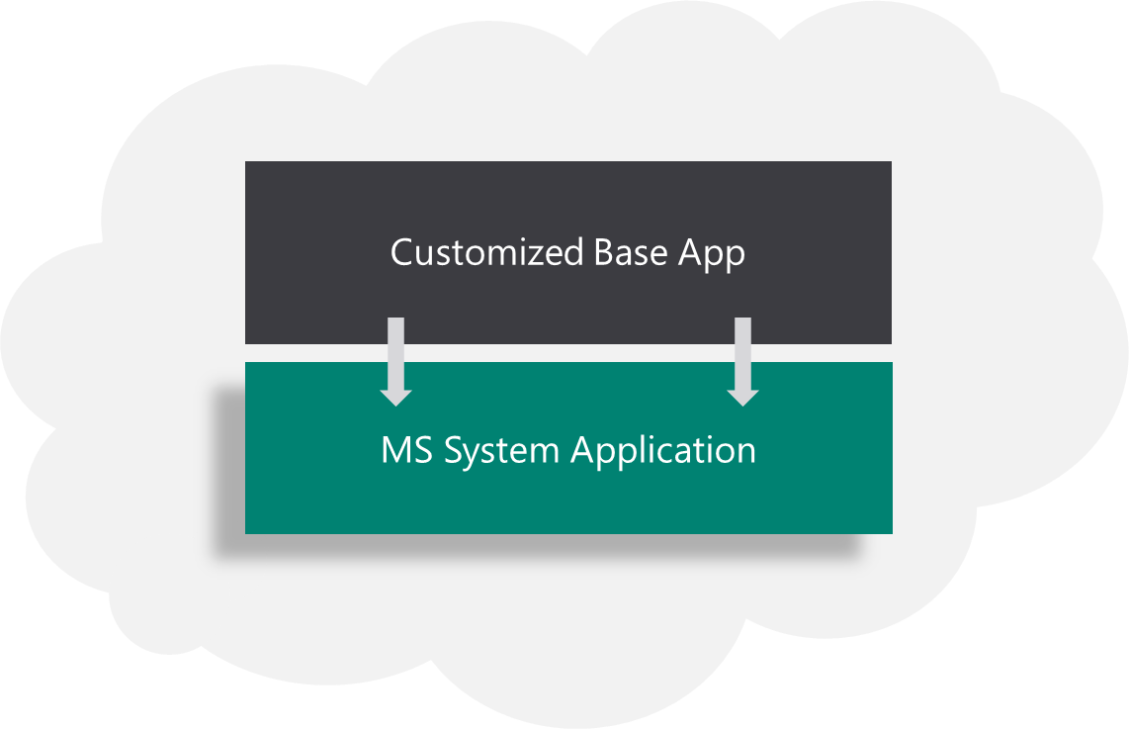
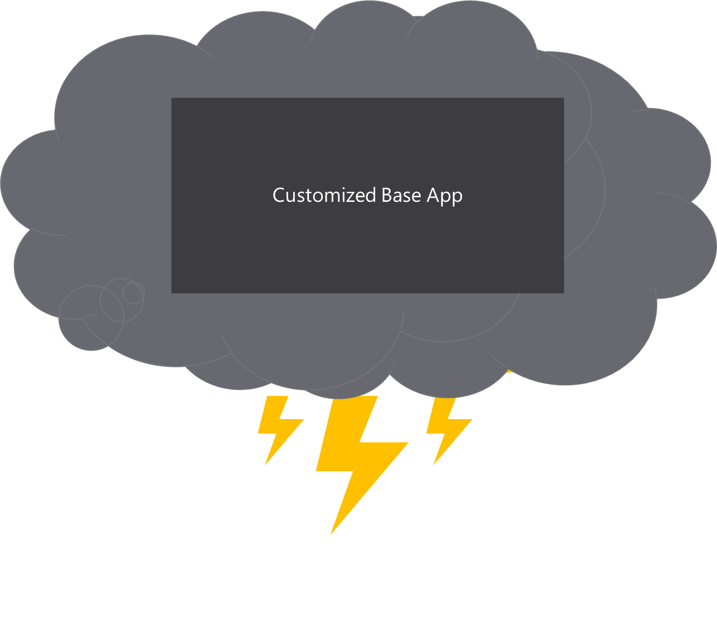
Upgrade journey – Step 3.
Step 3.
Uplift data to cloud
Step 2.
Upgrade to 15.x
Step 1.
Upgrade to 14.x
Only large vertical
solutions
OnPrem
14.X
(Spring 2019)
Not allowed
C/AL + AL
AL

Slide 50
Step 3 explained
If you have extracted all customizations, you can publish your app to the App Source or as Per Tenant Extension. This is the best architecture - we can support large number of extensions. It is easy to see if an issue is caused by an extension or the base app code. There is no merge needed, so entire solution is easy to support.
If you have refactored to use the System Application and still have customizations in BaseApp, you can get to the cloud if you are a large vertical solution. We want to keep the number of solutions in the cloud low, so this one is open only to large ISV Verticals. If you would like to join contact ready to go program.
We will not allow anyone to move to the cloud without System App refactoring. It is possible to host this architecture; however we do not want to allow this – refactoring to System App is minimum.
We will work in adding functionality to enable moving everyone to the topmost architecture.

Slide 51
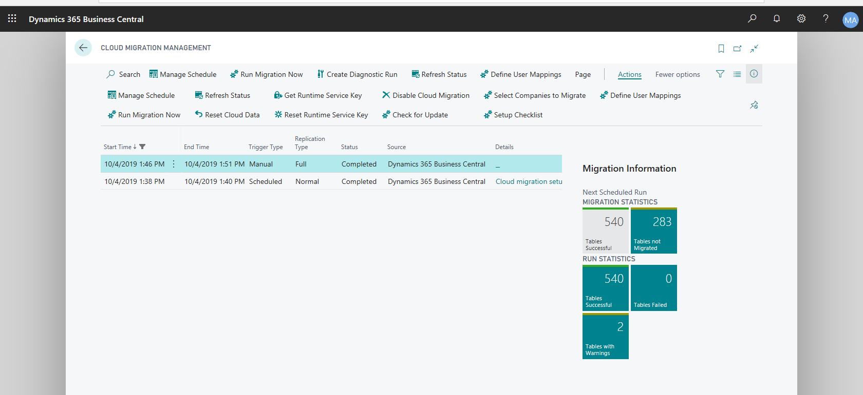
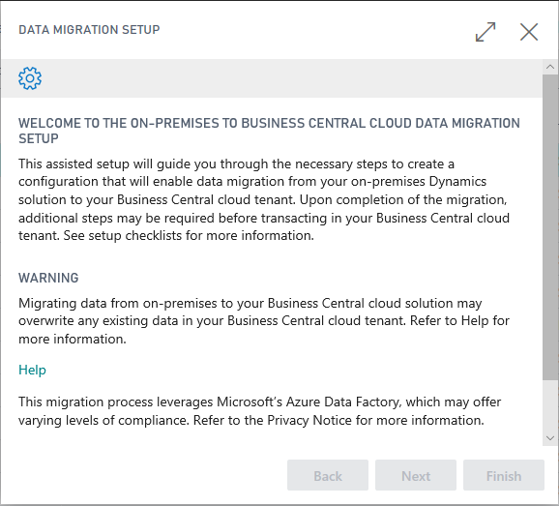

Step 3 – Uplift data to cloud
If you would like to migrate OnPrem to the cloud you should use Data Migration
It is a full migration tool now (Previously known as Intelligent Edge or Intelligent Cloud)
You can exclude the tables you own by setting Replicate data property
Get the cloud instance, complete the wizard + move data
See overview to ensure all data moved
Disable replication – You’re done!
This is a short overview, pictures with examples are in the next few slides

Slide 52
Overview/History of the Migration Tool
Release
Fall 2018 Release
Spring 2019 Release
Release 2019 Wave 2
First Release of “Intelligent Cloud Replication” tool
Business Central 13 to 13
Did not replicate ALL tables, all transaction tables but not all setup tables
Second Iteration of Intelligent Cloud Tool
Business Central 14 to 14
NAV2018 to Business Central 14
Full Migration tool
Business Central 15 to 15
Added additional setup/processes to make this a true Migration tool from on Premises to Cloud

Slide 53
Set up Cloud Migration Wizard
Welcome page
Read the warning, privacy and help information before configuring your Cloud Migration environment
Data migration will overwrite any existing matching data you have stored in your Business Central (SaaS) tenant.
All users that do not have ‘SUPER’ permissions will be assigned to new Intelligent Cloud user group
Cloud Migration configuration will have no impact on your on-premises solution or SQL Database
Notes:
Brian

Slide 54
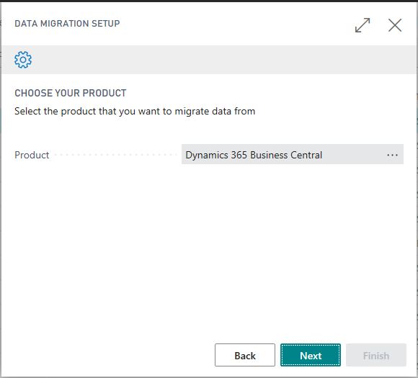
Set up Cloud Migration Wizard
Product Selection
Available products are determined by the extensions that support the Cloud Migration
Product & Data Availability
Business Central 15.x (on-premises) – 2019 Wave 2 Release
*For a customer on an older version of NAV or Business Central they can preform an on premises upgrade and then they can migrate to the cloud.
Notes:
Brian

Slide 55
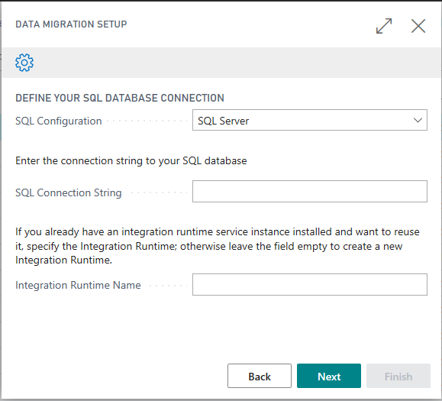
Set up Cloud Migration Wizard
SQL & Runtime Settings
Support SQL Server & Azure SQL
SQL Connection uses SQL Authentication to connect
Connection string is securely passed to Azure and stored in Azure key vault
Integration Runtime will be created if field is left blank
To add new tenants to an existing runtime service, enter the name of the existing service
Notes:
Brian

Slide 56
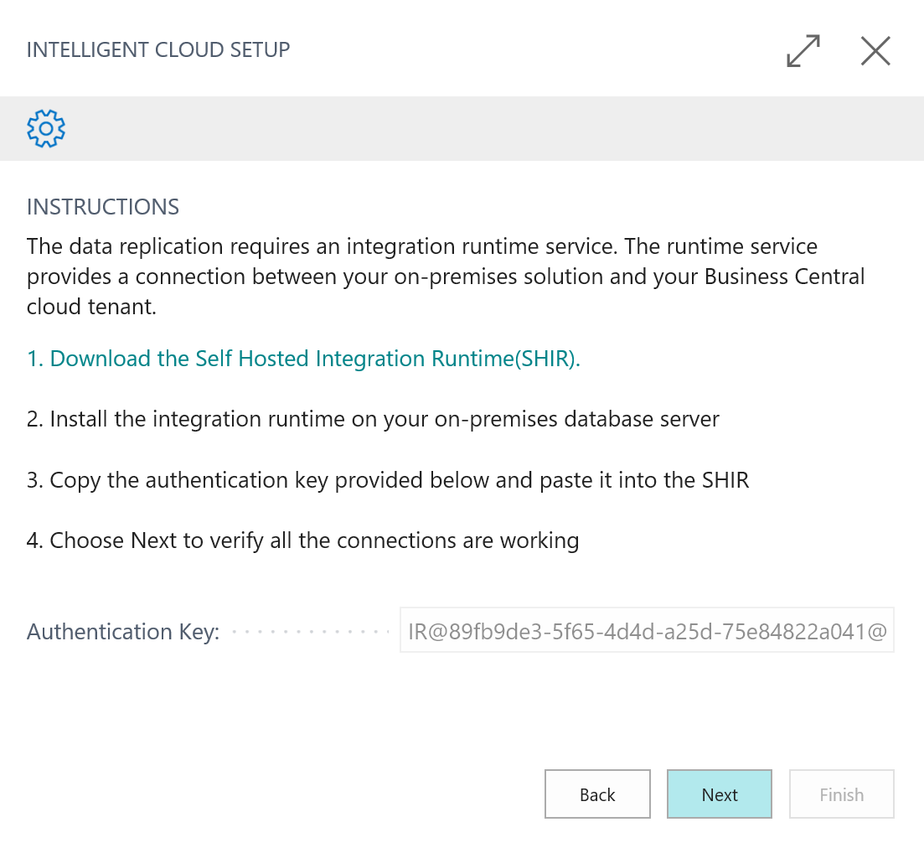
Set up Cloud Migration Wizard
Integration Runtime Service
Download Self Hosted Integration Runtime (SHIR)
Enables connection between on-premises data and cloud tenant
Provides secure pipeline to replicate data
Only need to install once, supports multiple data pipelines
No data is stored in the pipeline
SQL to SQL data migration
Notes:
Brian

Slide 57
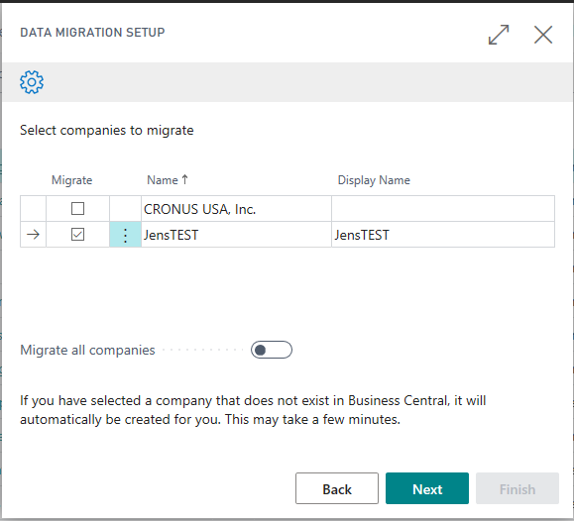
Set up Cloud Migration Wizard
Company selection
Select companies you want to migrate data from
Company list is determined by on-premises solution
If an on-premise company does not exist in your Business Central (SaaS) tenant, it will be automatically created before data is replicated
You must run the wizard each time you wish to update the companies you are replicating data from
** new option in the management page actions to add additional companies to the replication
Notes:
Brian

Slide 58
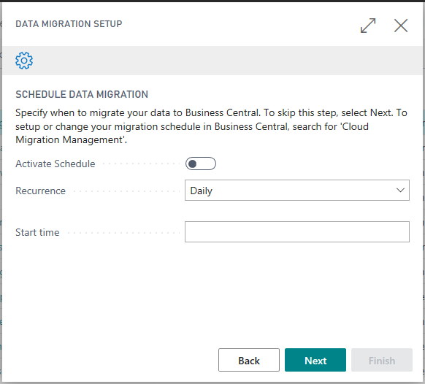
Set up Cloud Migration Wizard
Scheduling data migration
Activate to ‘enable’ data replication
Recurrences can be set to daily or weekly
Weekly recurrences enables day of the week selection
Recommended that migration be set to run during off hours
** This isn’t necessary if you plan on doing a true migration, you can leave it deactivated
Notes:
Brian

Slide 59
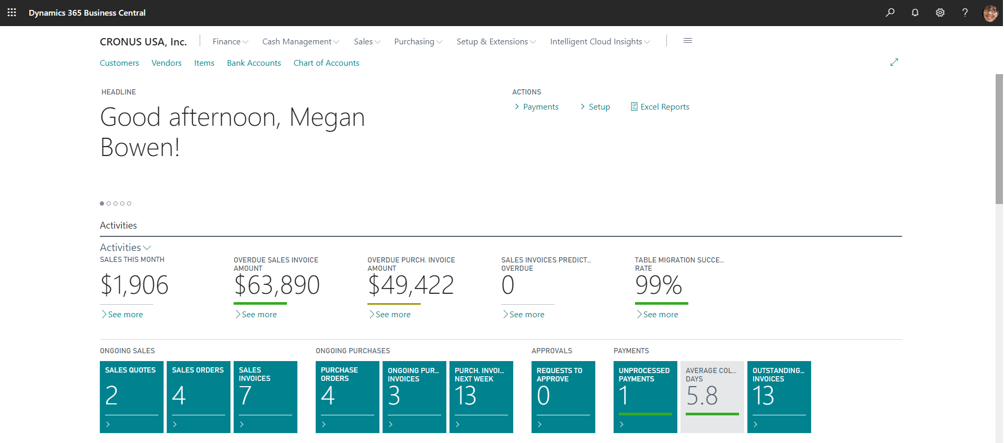
Application updates
Role Center
Action/action groups that users no longer have permission to will be hidden
Replication success rate tile is visible on the role center
Intelligent Cloud Management page become available
System Wide
User notifications where data replication was not successful.
Helps avoid users making decision on stale data
Notes:
Brian

Slide 60
Cloud Migration Management
Data migration
Azure Data Factory (ADF) is used to securely migrate data from your on-premises solution SQL Database to Business Central (SaaS) tenant
Data replication can be scheduled or manually triggered
Only core on-premises data + Extension data will be replicated
Data from customized table, users, user permissions, and most system tables will not be replicated
The tables that are replicated are determined by the cloud tenant; if something in the cloud but not on premise, you will get a warning.
Notes:
Brian

Slide 61
Cloud Migration Management
Manage Schedule
Refresh Status
Get Runtime Service Key
Disable Cloud Migration
Select Companies to Migrate
Define User Mappings
Run Migration Now
Setup Cloud Data
Reset Runtime Service Key
Check for Update
Setup Checklist
Notes:
Jen

Slide 62
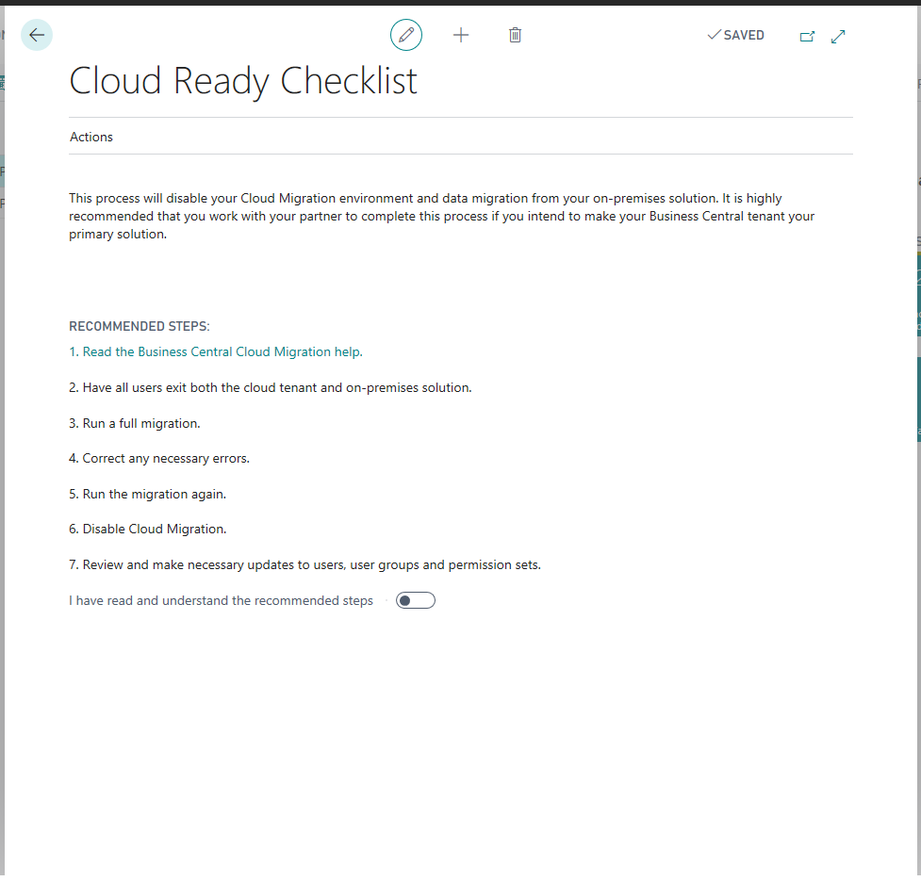
Disable Cloud Migration
Can be done at any time if doing the migration in phases.
Reason to disable
No longer want to replicate data
Make Business Central (SaaS) primary solution (migration story)
Recommend to follow steps listed
Removes Azure Data Factory pipeline
Will need to run wizard again if you want to configure Intelligent Cloud environment
Disable Intelligent Cloud Action
Notes:
Jen

Slide 63
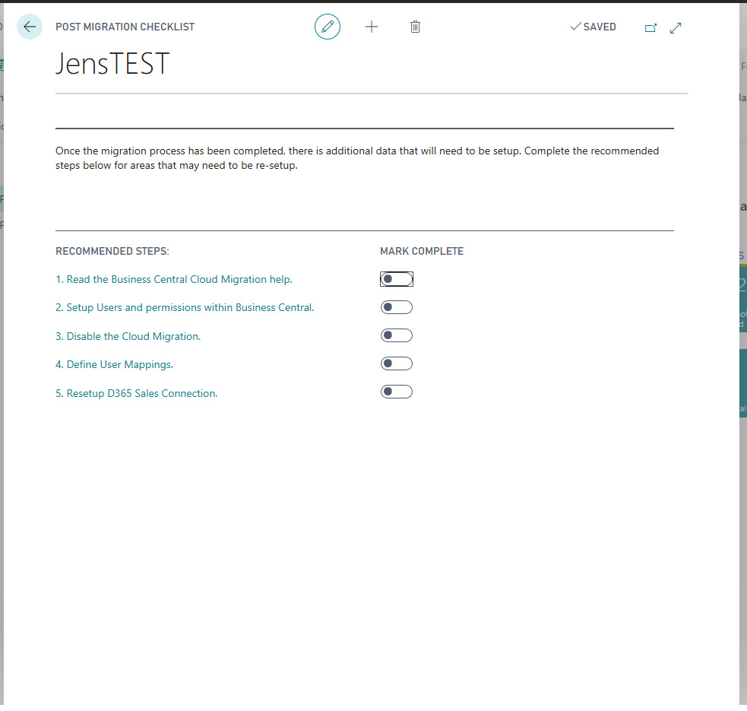
Post Migration Setup Checklist
Recommended Steps in Each Company
Available after the Migration has been run
Not all steps are required/manually mark as complete

Slide 64

Upgrade tooling

Slide 65
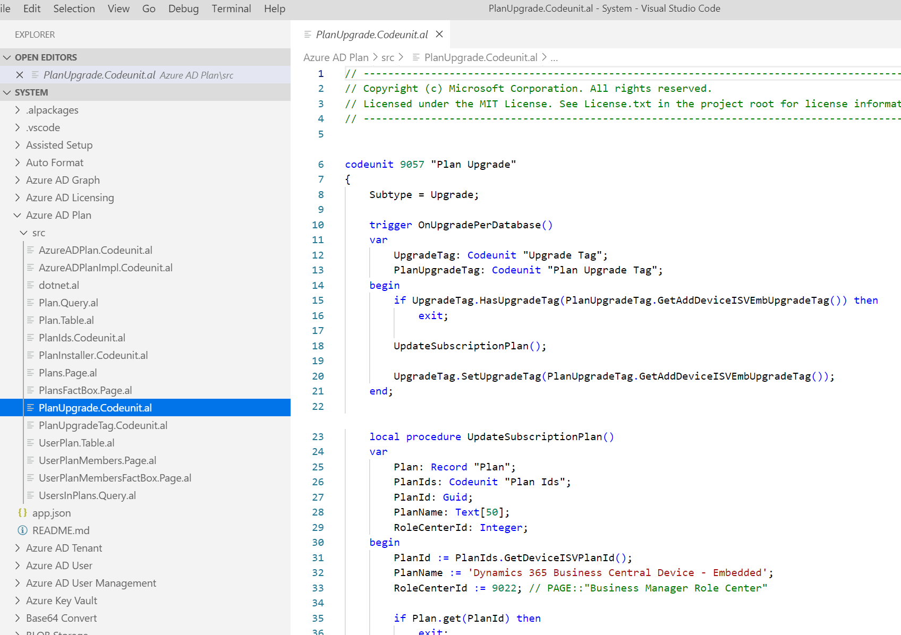
Where is the upgrade toolkit?
Included in every app
Stays as part of the app
Needs to be close to the code it upgrades
For System App each of the folders will contain upgrade codeunits

Slide 66
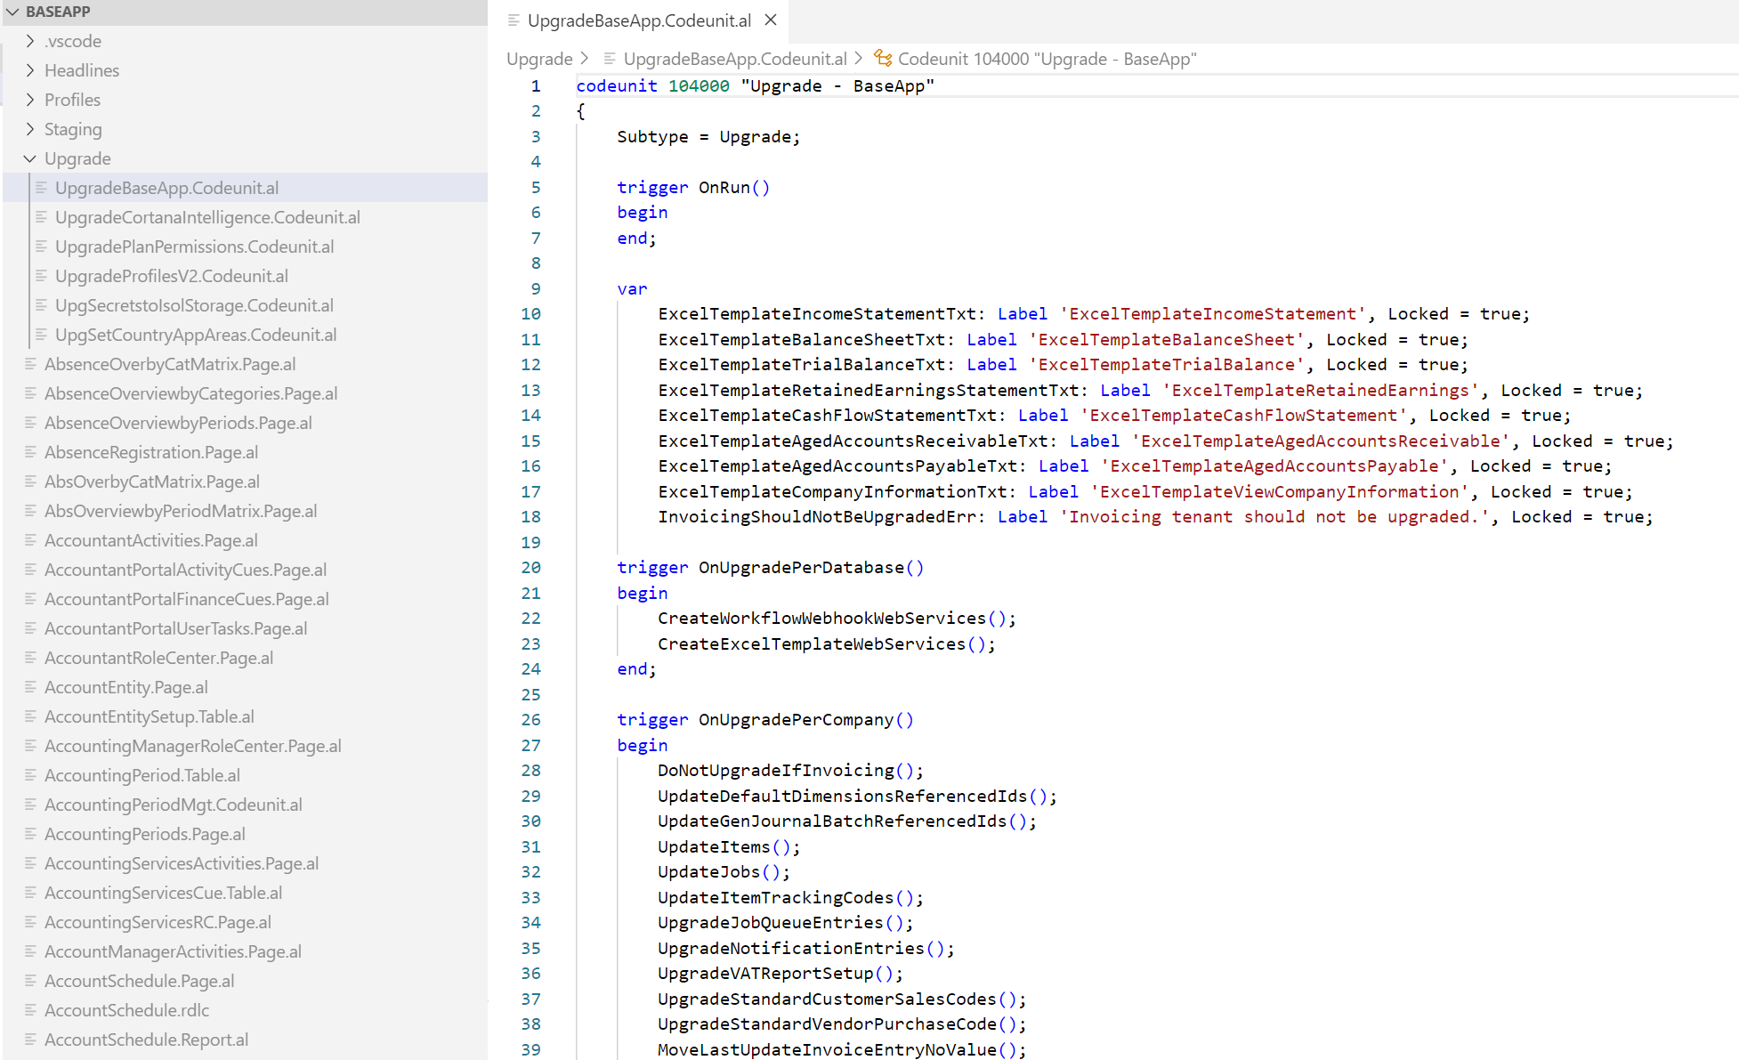
Base app upgrade toolkit
In upgrade folder
(because it is not fun to search in 6151 objects, we don’t consider this a good practice)
Use multiple upgrade codeunits for unrelated code
Rule is Separate areas = Separate codeunits
(the order must not matter)

Slide 67
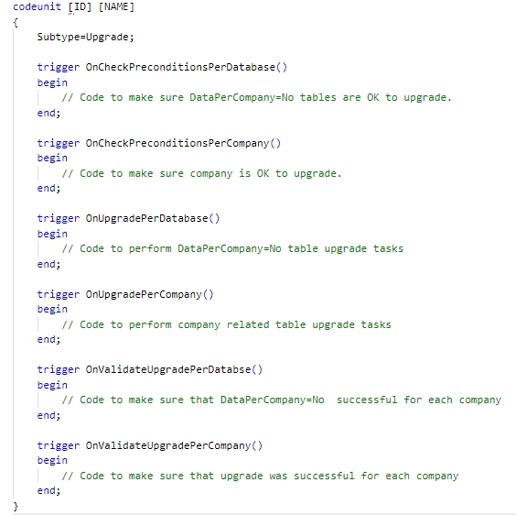
Upgrade codeunit structure
Check Preconditions and Validate methods can be time consuming
Make sure methods run only if necessary (not on every upgrade)

Slide 68
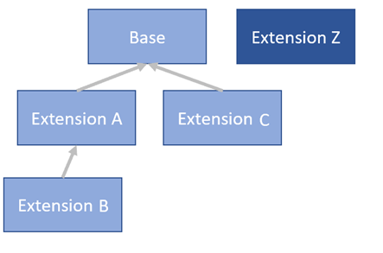
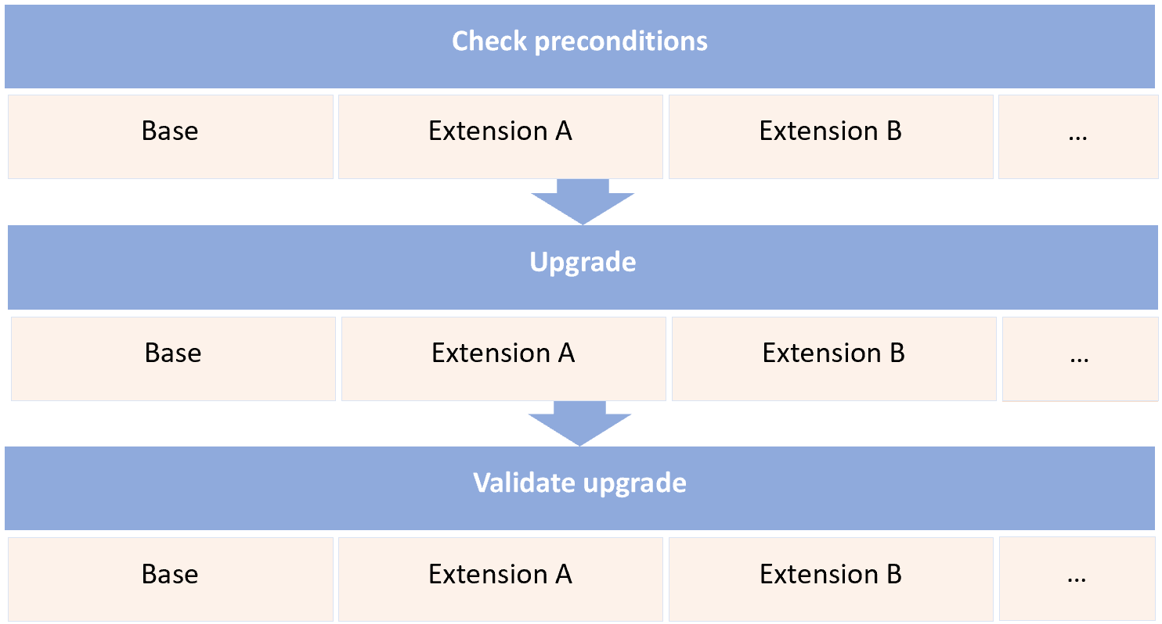
Upgrade codeunit – Execution order
We execute all check precondition methods for all extensions (following dependency order), then do the same for Upgrade and then invoke validate upgrade triggers

Slide 69
Let’s write some upgrade code!

Slide 70
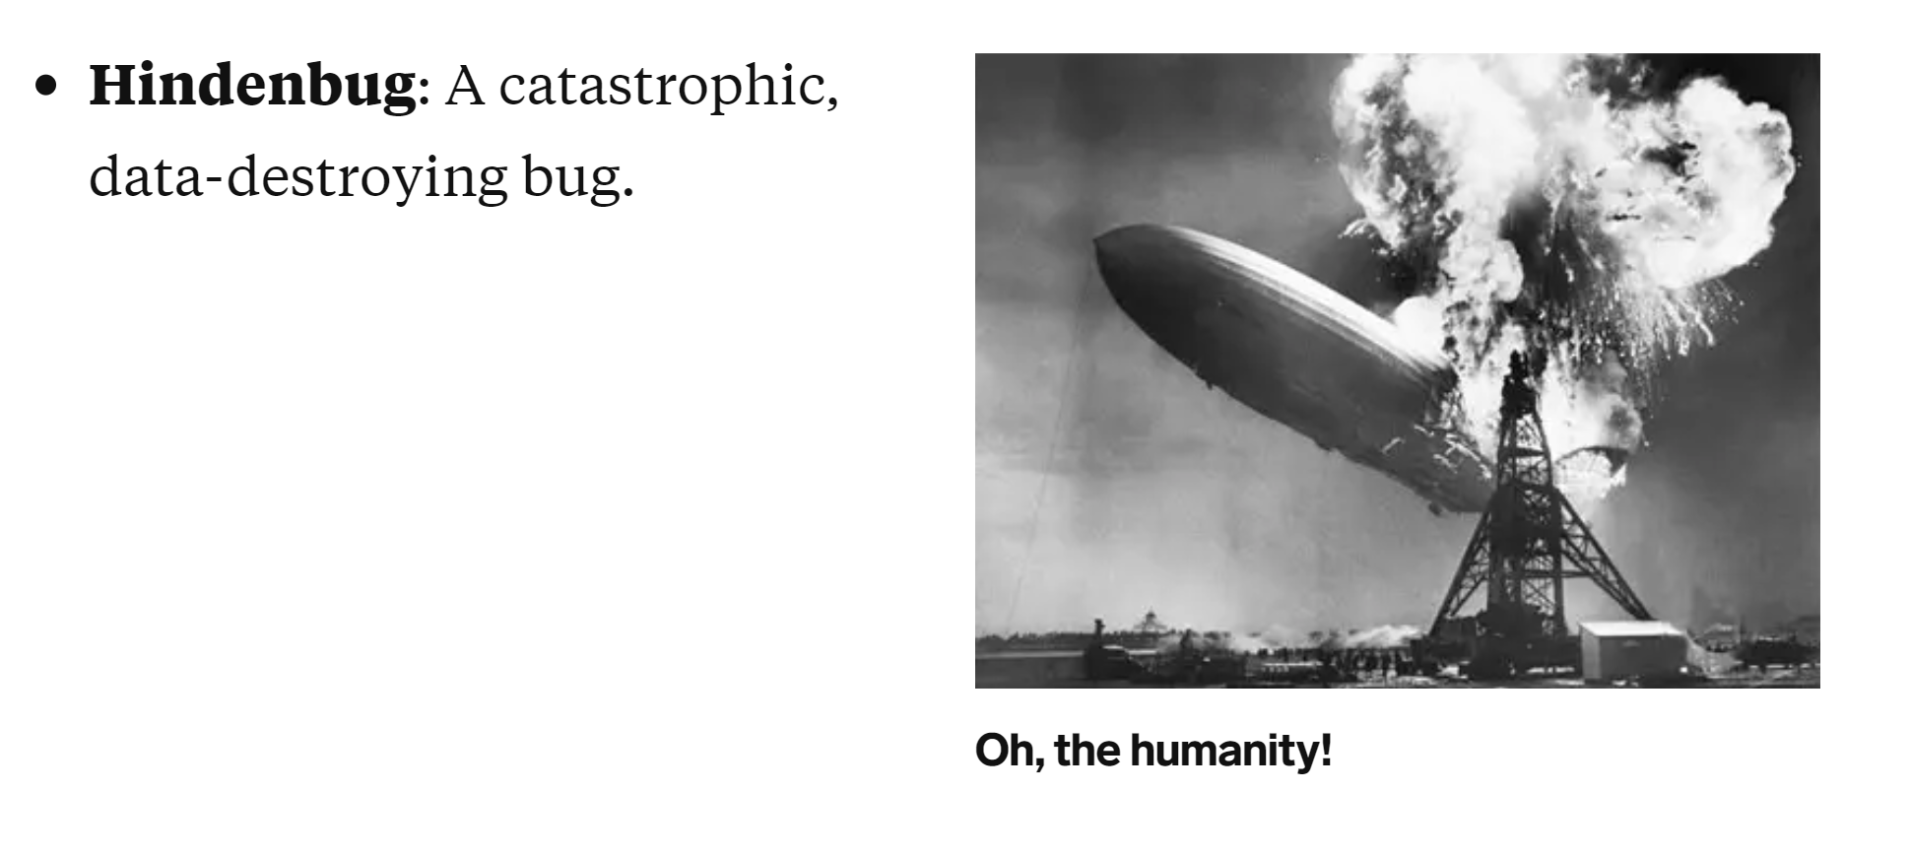
What is the worst that can happen during upgrade?
Hindenbugs
Starts with Customer call:
Where is my data?

Slide 71
Hindenbugs are painfull
Problem definition:
Users have been using system for few days so we cannot simply restore from backup
We must merge the data – see which records were lost and merge them with the records user entered
Open question - Can you handle 100 Hindenbugs in parallel?

Slide 72
What should we do?
Design for upgrade
Define an upgrade strategy
Can we even upgrade?
Keep upgrade code simple
If you are writing a lot of upgrade code, you are doing it wrong
5 mins review
3. High code quality
No hacks
Write tests – example of the gate is in the PowerShell. Upgrade tests we use are shipped on DVD and Docker.

Slide 73
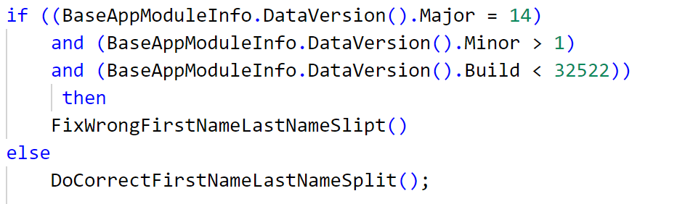
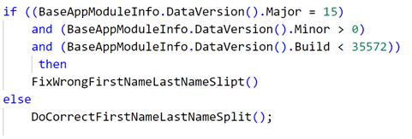
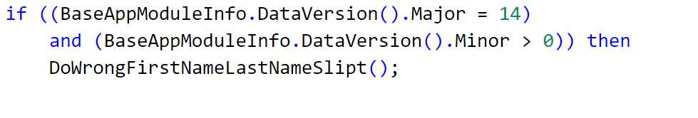
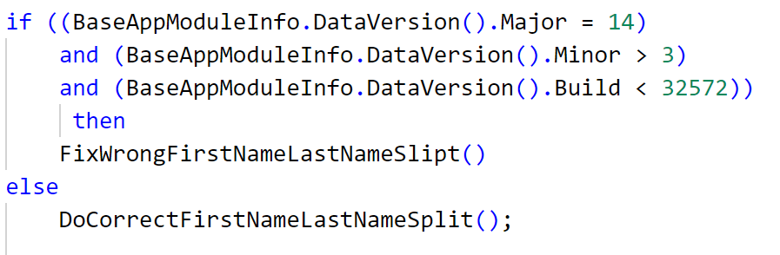
Fixing upgrade gone wrong – Slide is animated
Task - Split Name to First Name and Last Name
Update 13
Update 14.1
Update 15
No Upgrade
(Best Upgrade)
The code is broken, upgrade paths are incorrect
Update 14.3

Slide 74
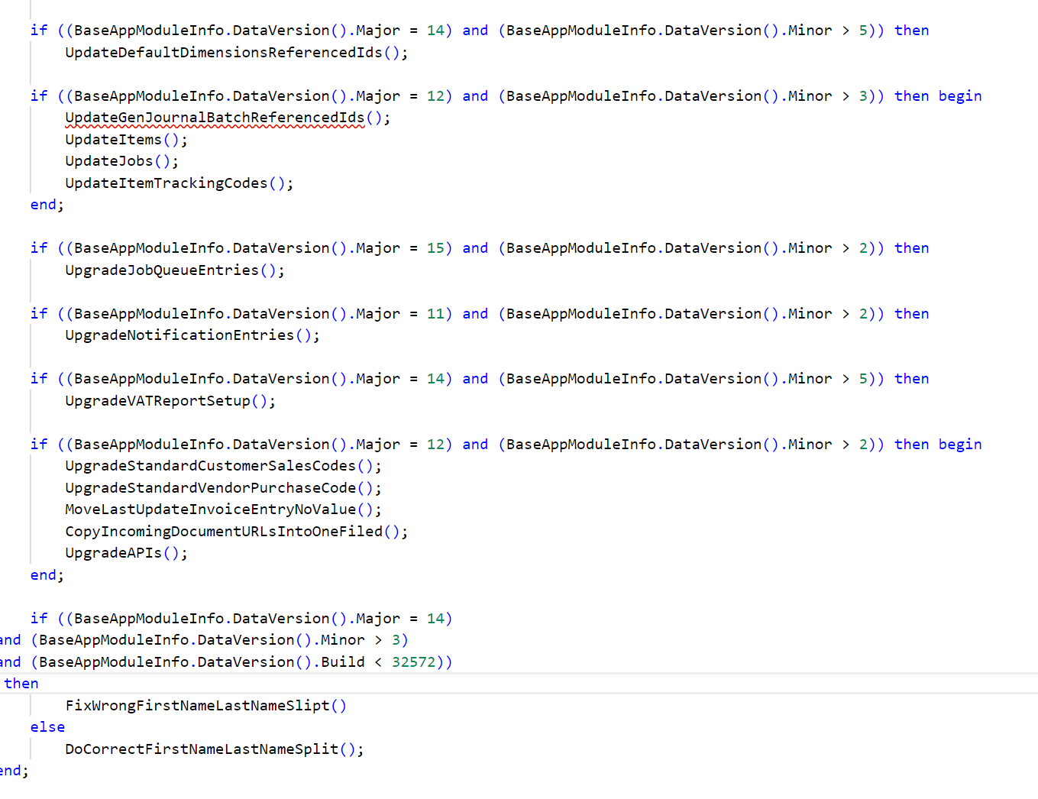
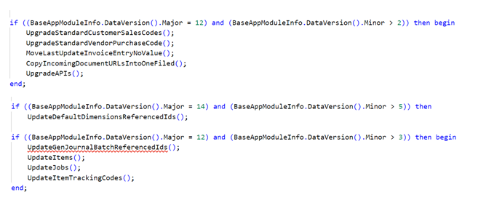
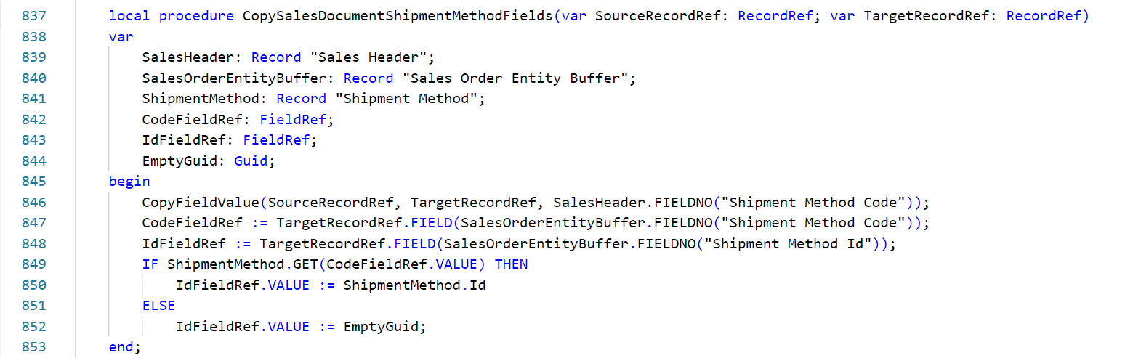
What it would look like if we used version numbers for all methods Version numbers, version number everywhere…
+5 other codeunits

Slide 75
Version numbers do not work for large applications
Difficult to get an overview
Difficult to control code execution
Difficult to port changes
Too many version numbers – version has no meaning
Version number does not mean anything for BaseApp since it is generated automatically during build process

Slide 76
When to use version numbers
Small application
Version changes rarely – once per every 1-2 years
Version is set manually
It is OK to check if it is a first installation by comparing with 0.0.0.0
In manifest if you depend on certain functionality it is OK to set the version number to the build number. You can publish to SaaS immediately (App store or upload PTE). We will wait with upgrading the extension until the numbers specified in the manifest are reached.

Slide 77
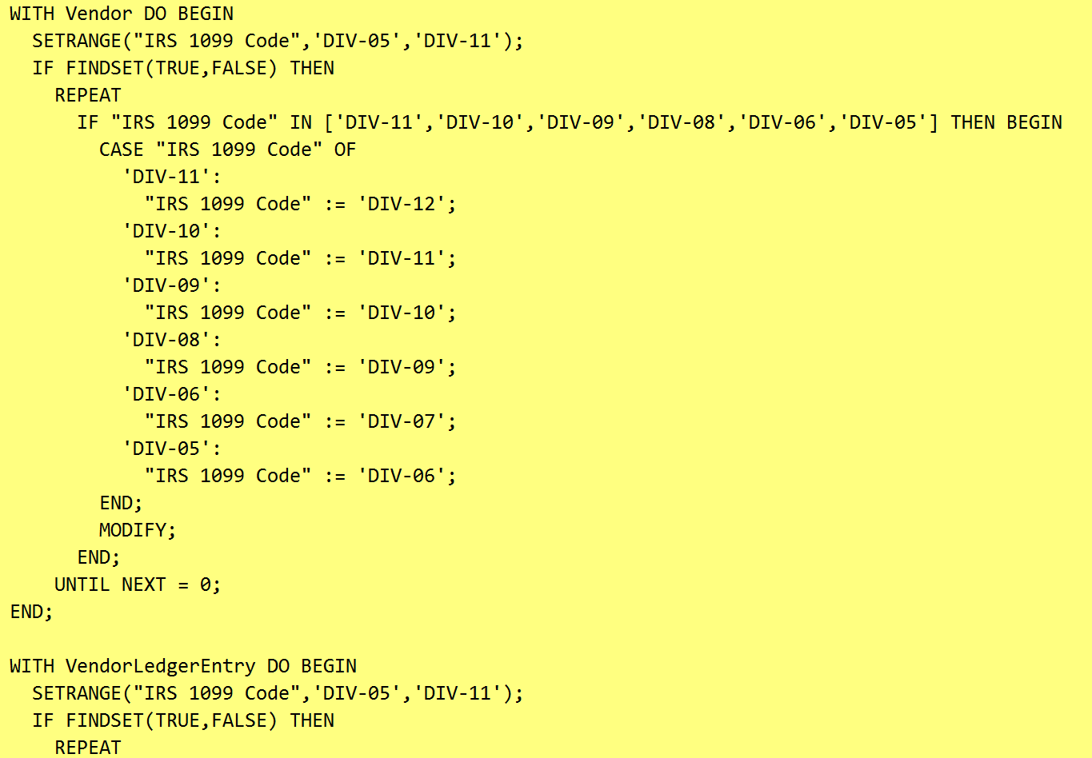
Not safe to run twice
IRS 1099 upgrade code
If we run twice we will roll 11 to 12 – causing data loss

Slide 78
Not safe to run twice 2
Shoe Size upgrade code
Obsolete removed will break data if is running twice

Slide 79
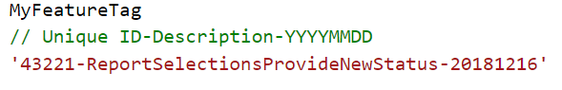

Upgrade tags – Wrap code within upgrade tag

Slide 80

Upgrade tags table

Slide 81

Fixing upgrade gone wrong
Task - Split Name to First Name and Last Name
Update 13
Update 14.1
Update 15
No Upgrade
(Best Upgrade)
Update 14.5

Slide 82

Scenario: Create a new company Users set some shoe sizes to customers What will happen on next upgrade? We will copy over the old values, replacing any changes user did – data loss

Slide 83


Upgrade tag definitions
The subscribers are used for New Companies
We need to register the tags for the new companies to avoid issues

Slide 84
Upgrade tag weakness
New companies
New installation
In these scenarios if you do not register upgrade tags, we risk to execute the code twice.
Use subscribers and / or UpgradeTag.SetAllUpgradeTags (registers all tags present in the system)
We will harden this extension with additional tests

Slide 85
Where is the code
Upgrade tags - System Application
You can join at GitHub and provide feedback or feature requests
Before 15.x: Codeunit and Table 9999
Can move to any version (C/AL objects only, simply copy)
Codeunit 9998 holds all definitions

Slide 86
Upgrade tags - Guidelines
Don’t go crazy
2 level nesting max – complicated if statement may lead to bugs
Use only in upgrade
Duplicate the code and rename objects if you want to use for other purposes
Don’t forget new users / companies
Insert tags from OnInstall and for new companies

Slide 87
Execution context API
Upgrade can roll back SQL changes. If we call to the outside webservice, physically print or sync to an outside storage like CRM we cannot undo that
Execution context API helps to prevent invoking sensitive code during upgrade
You can also use it to detect if the extension is installing or uninstalling

Slide 88


Execution context API

Slide 89


Code example
GetExecutionContext will protect from invoking code during upgrade
GetCurretnmoduleExecutionContext checks if it is the current extension that is upgrading. In this case we throw an error because we should not invoke this code during upgrade

Slide 90
Obsolete properties
Added obsolete properties on all objects
Compilation errors now (In 14.x invoking obsolete properties throws runtime errors only)
Mark as removed – only upgrade and installation code* can access it
*Only first installation – DataVersion – 0.0.0.0
Extension uplift

Slide 91

DestinationAppsForMigration
Two usages:
1. Resolves references for manifests before 15.x – if the old application is not listing Base Application as dependency it will continue to work
2. Installs apps automatically during upgrade
(Publish the extension, Sync and call Start-NAVDataUpgrade)

Slide 92
Destination Apps For Migration FAQ?
Q: What should we add to this list?
A: Anything that was moved from C/AL to AL extension should be listed at minimum. This would be System Application and Base Application.
Q: Can I add my own extensions?
A: Off course. Everything is an extension in AL and they are treated the same (Base App and third party extensions are same).
Q: Can I add an extension that was not present in C/AL to chain the upgrade?
A: Yes, if you want to install it together with System Application and Base Application, you can add any extension to the list
Q: Is there any performance impact in listing many extensions
A: None that we know of

Slide 93

DestinationAppsForMigration – Example from upgrade script
We publish, sync and call upgrade
Start-NAVDataUpgrade will “Install” the extensions without invoking OnInstall codeunit, but invoking upgrade codeunit directly

Slide 94

Old manifest file
DestinationAppsForMigration
will resolve missing application version to the extension if it is listed

Slide 95
Destination Apps For Migration FAQ
1. Can I add many extensions to the list?
Yes as many as you want
2. Does the extension need to have C/AL object? What if I’m only added new objects?
It doesn’t, you can use this mechanism to install any extension with system App and base app. We publish Upgrade-Tests and Library Assert that had no C/AL objects in the base
3. My extension is standalone, do I need destination apps for migration?
You need baseApp and SystemApp, you may or may not set your extension as the destination app for migration. If you use global triggers add it to the list so it can listen
4. How do I decide the destination apps for migration?
You can add any that you want, it has no performance impact. If it was an extension before upgrade, you should not add it to the list.

Slide 96

Upgrade script
You can find the example scripts at:
https://github.com/microsoft/BCUpgrade/blob/master/15X%20-%20Business%20Central%202019%20Wave%202/Example/UpgradeLibrary.psm1
We will ship upgrade tests (Docker/DVD)
You should setup you CI/CD to upgrade and run upgrade tests

Slide 97
Test-NAVTenantDatabaseSchema
Test-NAVTenantDatabaseSchema -ServerInstance $ServerInstanceName -Tenant $tenant.Id
This cmdlet will test if all of the tables were moved.
It compares NAV App Object metadata with the actual SQL definition
If anything is not matching it will fail. This is useful to discover orphaned tables or tables that were not generated in the SQL.
Analyze any problem reported. Most common issues:
1. Name or the ID does not match between C/AL and AL
2. Keys between C/AL and AL do not match. Double check if the primary and secondary keys are the same

Slide 98
Troubleshooting the upgrade
Check the event log
Errors with message is logged under application
Post the issue on the github if you cannot solve it yourself, we will add the solution to the commonly asked questions

Slide 99
What about SaaS to SaaS Upgrade?
Have you forgotten?
14.5 Cloud
(Spring 2019)
15.0 Cloud
(2019 Wave 2)

Slide 100
If the 14.x (or before) extension is working properly with 15.x you do not need to do anything No changes are needed

Slide 101

Broken extension – What to do?
1. Get the new docker build
2. Fix the issue
+ Set the application / platform dependencies
4. Publish new extension to app store
(Upload if it is PTE – Per tenant Extension)
Once we update the tenant to specified application/platform version we will upgrade the app automatically

Slide 102

Getting the docker builds
https://blogs.msdn.microsoft.com/freddyk/2018/04/16/which-docker-image-is-the-right-for-you/

Slide 103
Thank you!
Link to slides:
https://aka.ms/BCUpgradeDeck
The BIG Deck
The deck will be updated on feedback/questions
https://twitter.com/nikolakukrika
Nikola Kukrika (Yammer)

